Slide 1
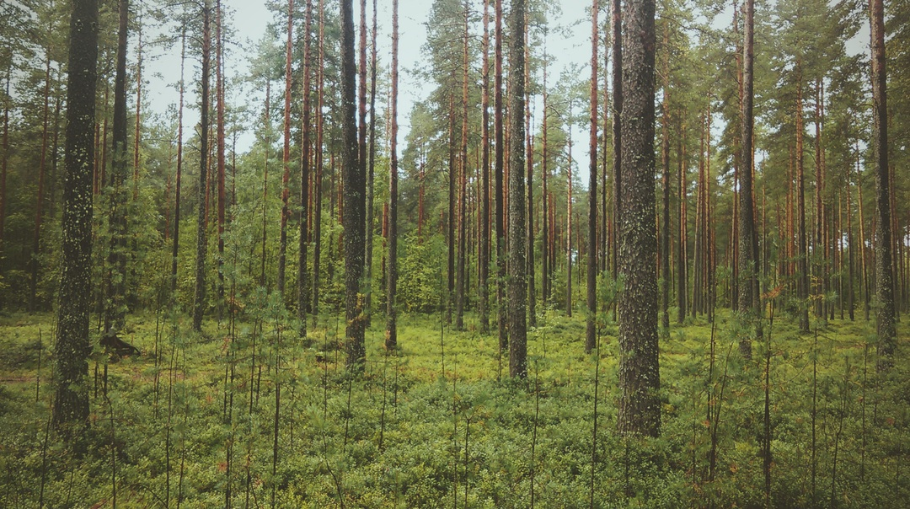
Time series of forest & LAI change in Lithuania
Team Rython
Dainius Masiliunas & Tim Weerman
January 29, 2016

Slide 2
Hypothesis
According to the Lithuanian government the forest coverage is increasing. Yet our hypothesis is that large trees are being replaced by saplings causing a decrease in LAI.
Research question:
Is the forest cover trend that is provided by the government comparable with the trend that is visible from the LAI satellite data?

Slide 3
Objective
To estimate the trend of vegetation growth in Lithuania using satellite data
MODIS, Leaf Area Index, 8-Day L4 Global 500m
Compare it with official statistics of forest coverage per municipality

Slide 4
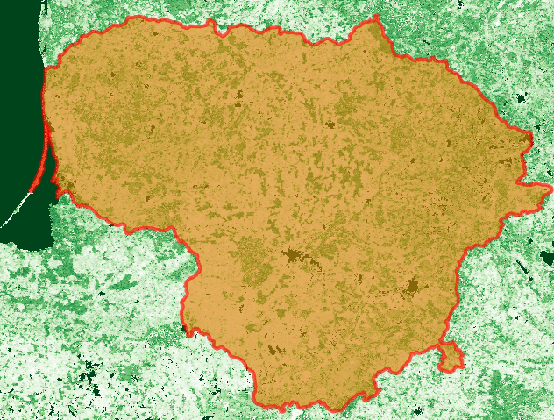
Raw MODIS data

Slide 5
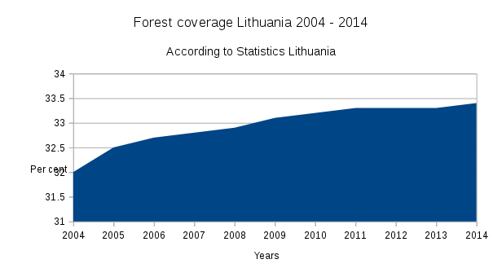
Official statistics of forest coverage

Slide 6
Method
Data processing
  Download files from USGS
  Process with bfastSpatial
    Mask pixels
    Generate yearly statistics (mean, median, 75th & 90th percentile, maximum)
Notes:
Generating yearly statistics is really slow

Slide 7
Method
Merge satellite data with government data
  Extract municipality data using GADM boundaries
  Merge data from all the municipalities into one data frame
  Merge data frame with forest cover data from the government
  Extensive alterations to the municipality names to make the data sets match

Slide 8
Method
Generate .svg vector plots
  Create two Y-axis for a clearer plot
  Plot a line per statistic
Create a Leaflet .html
  Polygons from GADM
  Summary of the LAI raster
  Pop-ups per municipality with the graphs
  Centralised marker for the country

Slide 9
Results
See: output/html/Municipalities.html
Notes:
Start with the whole country
Increase in forest cover (as in the previous graph)
LAI increasing faster and more fluctuations
Hypothesis appears to be wrong
Neringa (forest fire 2014 and weird distribution)
Varena (pine forest, lower LAI)
Vilnius (similar trends)
Svencionys (nice positive trend)
Silute (high rise 2014, reformation of borders?)

Slide 10
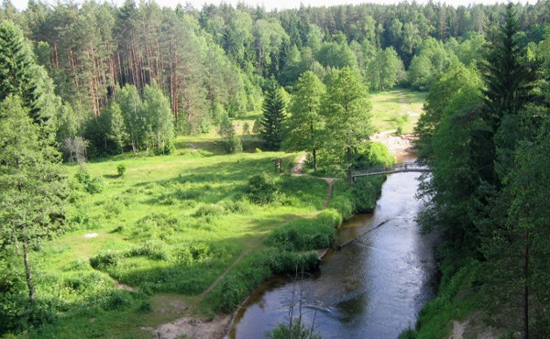
Questions?
Thanks for listening

